Slide 1

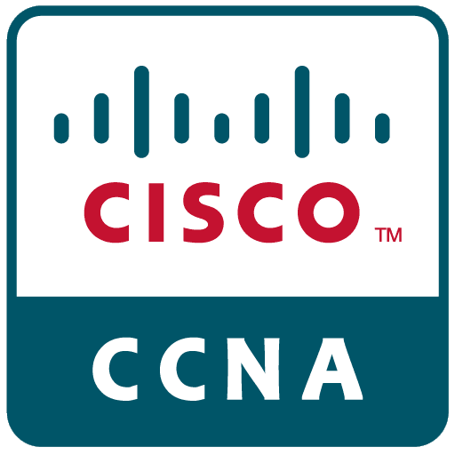

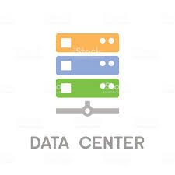

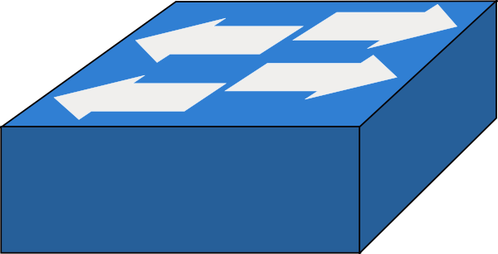

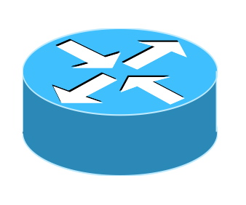


CCNA 200-301 DAY-2
NETWORK DEVICES?
WHAT IS THE NETWORK?
WHAT IS THE NETWORKING?
KAPIL KUMAR

Slide 2

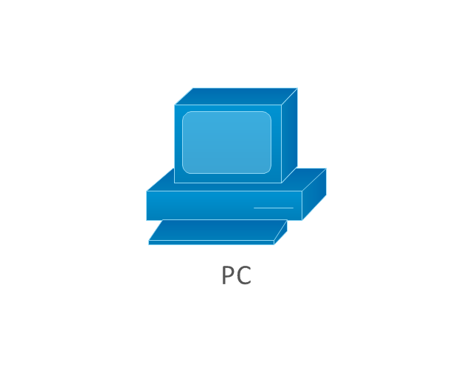

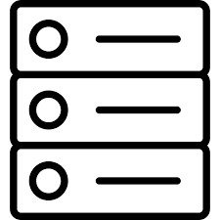
NETWORK DEVICES?
The devices which are used for communication between different hardware’s used in the computer network are known as network devices. These devices are also known as physical devices, networking hardware, and network equipment otherwise computer networking devices. In a computer network, each network device plays a key role based on their functionality, and also works for different purposes at different segments.

Slide 3
NETWORK DEVICES?
ROUTER!
The router is a physical or virtual internetworking device that is designed to receive, analyze, and forward data packets between computer networks.
A router examines a destination IP address of a given data packet, and it uses the headers and forwarding tables to decide the best way to transfer the packets
A router works on the third layer of the OSI model, and it is based on the IP address of a computer.
It uses protocols such as ICMP to communicate between two or more networks.
It is also known as an intelligent device as it can calculate the best route to pass the network packets from source to the destination automatically.
It connects two or more different network, it could be LAN or it could be WAN.
By default router’s behaviour is unicast but we can change the behaviour.

Slide 4
NETWORK DEVICES?
SWITCH
A network switch is a centralizes communications among several connected devices in one local area network (LAN).
Switches allow you to control who has access to various parts of the network.
Switches work at Layer 2 of the OSI model, not Layer 1 like a hub
Switches don’t look at IP address information, only Ethernet MAC addresses information.
Switches keep a table of all MAC addresses traversing the switch and what port they are on (this table is called the bridge forwarding table or CAM table)
Switches only send traffic to the devices that are the destination for that traffic, saving bandwidth.
Each device connected to the switch gets the full bandwidth of the switch port because the switch prevents collisions.
Each port on a switch is in a separate collision domain and can run in the full-duplex mode, which means that hosts connected to a switch port can transmit to the switch at the same time that the switch transmits to them.
It manages the flow of data across a network by inspecting the incoming frame’s destination MAC address and forwarding the frame only to the host for which the message was intended.

Slide 5
NETWORK DEVICES?
Firewall
NETWORK DEVICES?
A firewall is a type of cybersecurity tool and network security device that monitors incoming and outgoing network traffic and permits or blocks data packets based on a set of security rules.
Firewalls can be used to separate network nodes from external traffic sources, internal traffic sources, or even specific applications.
Firewalls can be software, hardware, or cloud-based, with each type of firewall having its own unique pros and cons.
Its purpose is to establish a barrier between your internal network and incoming traffic from external sources (such as the internet) in order to block malicious traffic like viruses and hackers.

Slide 6
NETWORK DEVICES?
Server
A server is a computer or system that provides resources, data, services, or programs to other computers, known as clients, over a network. In theory, whenever computers share resources with client machines they are considered servers. There are many types of servers, including web servers, mail servers, and virtual servers.
Client
A client is a computer that connects to and uses the resources of a remote computer, or server. Many corporate networks comprise a client computer for each employee, each of which connects to the corporate server. The server provides resources like files, information, Internet and intranet access, and external processing power. In the case of processing, any work done on the server is referred to as "server-side" work. Any work done on the local client is similarly called "client-side."

Slide 7
WHAT IS THE NETWORK?
Physical Connection
Two and more devices are connected together via any media (wireless, wired, satellites) is called network.
WHAT IS THE NETWORKING?
Logical Connection
Two and more devices are connected together via any media and the connected device is share information with the help of physical and logical address, is called networking.

Slide 8
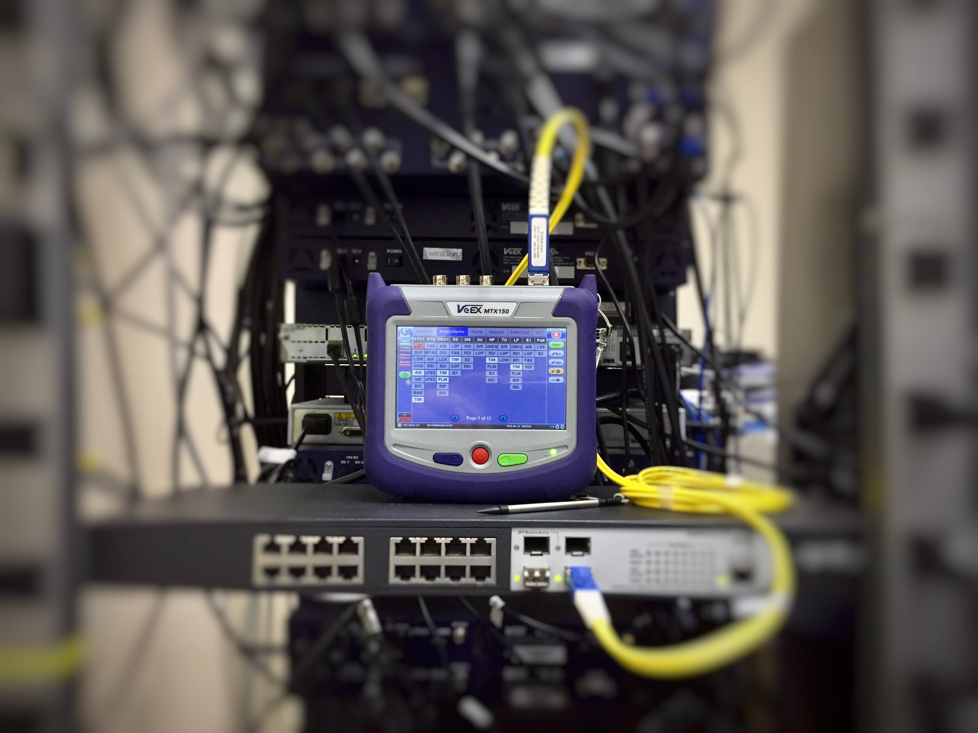
THANKS FOR WATCHING
DON’T FORGET TO
LIKE
COMMENT
SHARE
------------&-----------
SUBSCRIBE

